Slide 1

[TBC: POSTAGE INDICIA]
THINKING ABOUT YOURS?
Ask for a clear estimate. Property services, done properly.
[TBC: ADDRESS BLOCK]
Get a clear estimate
(512) 348-6433 · (512) 348-6232
choosecosmic.com
Notes:
print/04-postcard-neighbor-back

Slide 2
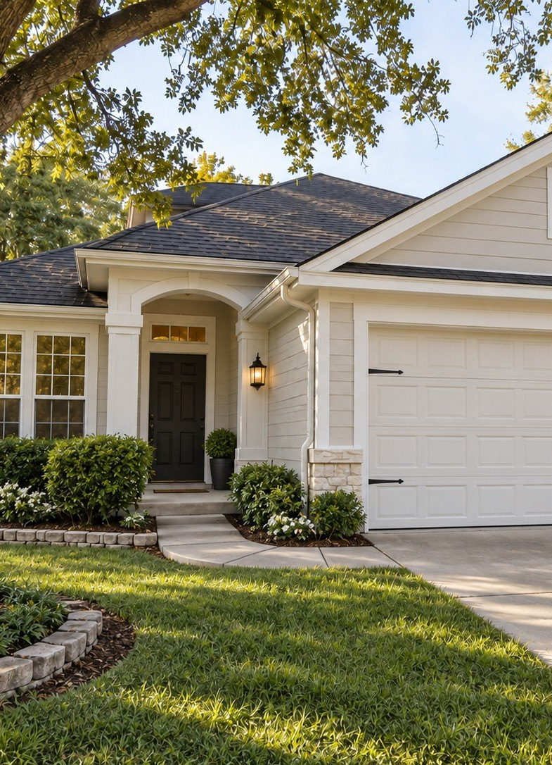

JUST FINISHED NEARBY
YOUR NEIGHBOR'S PLACE JUST GOT A FRESH LOOK.
Done properly by Cosmic on
[TBC: STREET]
Notes:
print/04-postcard-neighbor-front

